Slide 1
Geospatial Analysis of Hong Kong for Optimal Sportswear Store Location
Author: Preston Chou
Date: February 26, 2021

Slide 2
Introduction
Objective: Selecting the optimal location in Hong Kong to open a sportswear store
Method: An area’s potential will be measured through its A) number of fitness, clothing or shopping-related venues, B) most common venue types
Intended audiences:
Sportswear companies looking to optimize their current location strategy
New start-ups looking to enter the market
Hong Kong sportswear market analysts

Slide 3
Data Sources
Hong Kong Constituency Areas GeoJson: Border data for each of Hong Kong’s Constituency Areas and corresponding Districts
Nominatim Geocoder API: Coordinates of Hong Kong areas
Foursquare API: Venue data for each of Hong Kong’s areas

Slide 4
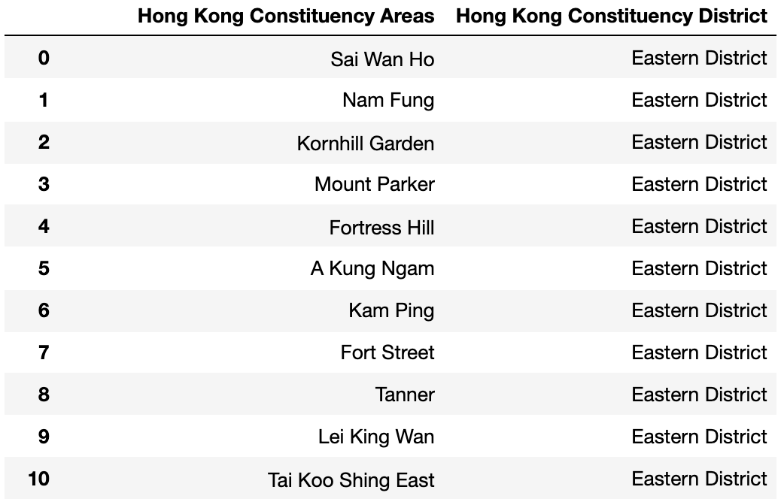
Data Cleaning and Processing: Hong Kong Constituency Areas GeoJson
We will extract the Constituency Areas and Districts from the file and put them into the columns of a new Pandas dataframe:

Slide 5
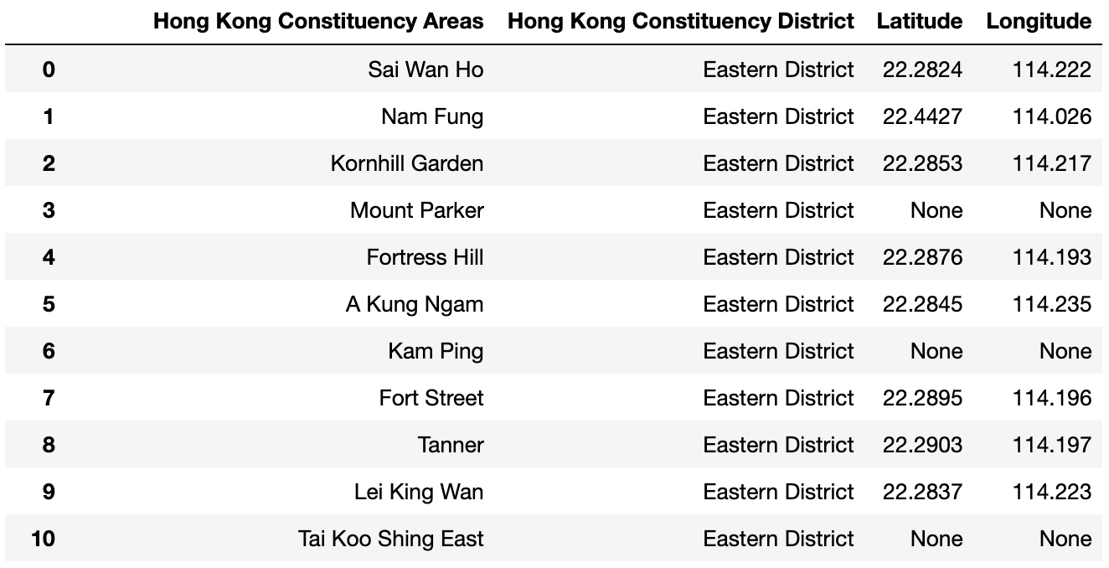
Data Cleaning & Processing: Nominatim Geocoder API Coordinate Data
The Geocoder API returns the most accurate coordinates when the input address includes the constituency area, followed by the district and the city ('Hong Kong'). However, this input format yields more 'None' values, which we need to deal with later on.

Slide 6
Data Cleaning & Processing: Nominatim Geocoder API Coordinate Data (cont’d)
The locations with no coordinates from the API belongs to 3 categories:
Includes the names that contain very specific sub-area terms (e.g. North, South, East, West, Upper, Lower)
Conjoins two or more names (via commas or ampersands)
Names simply too obscure for the Geocoder API
With different solutions:
Eliminate sub-area terms, consolidate names to one
Form separate names for this category.
Input address to API as the Constituency Area name with 'Hong Kong’ (more results but less accurate)

Slide 7
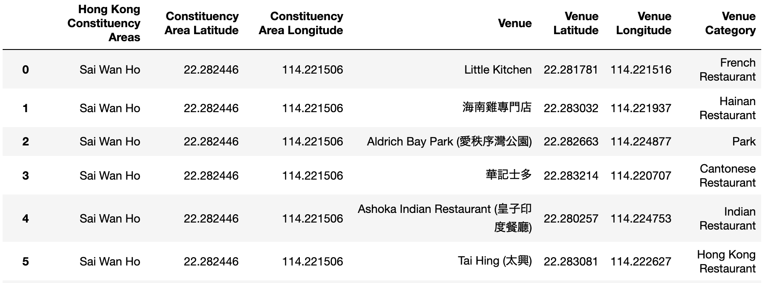
Data Cleaning & Processing: Foursquare API Venue Data
We will input the names and coordinates of each Area into the API, acquire up to 300 venues from a 500m radius. We create a new dataframe with a row for each venue:

Slide 8
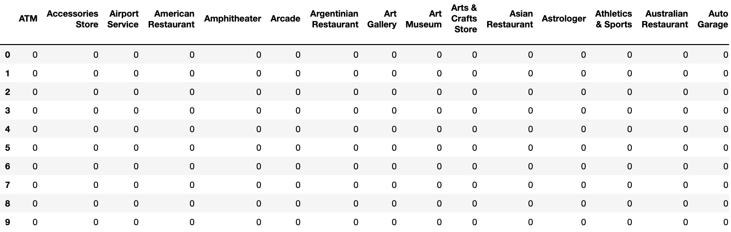
Data Cleaning & Processing: Foursquare API Venue Data (cont’d)
Based on this dataframe, we will produce a new dataframe with dummy values for the venue categories:
1
Not comprehensive for all categories

Slide 9
Data Cleaning & Processing: Foursquare API Venue Data (cont’d)
We will only choose to keep the venue categories containing fitness, clothing or shopping-related keywords. The keywords are:
We add a column with the Constituency Area names, group the dummy values by sum according to the Area names
We also add a column listing the Total number of venues for each Constituency Area
Sports
Sport
Sporting
Fitness
Gym
Studio
Field
Pool
Martial art
Court
Clothing
Fashion
Outdoor
Shoes
Shopping

Slide 10
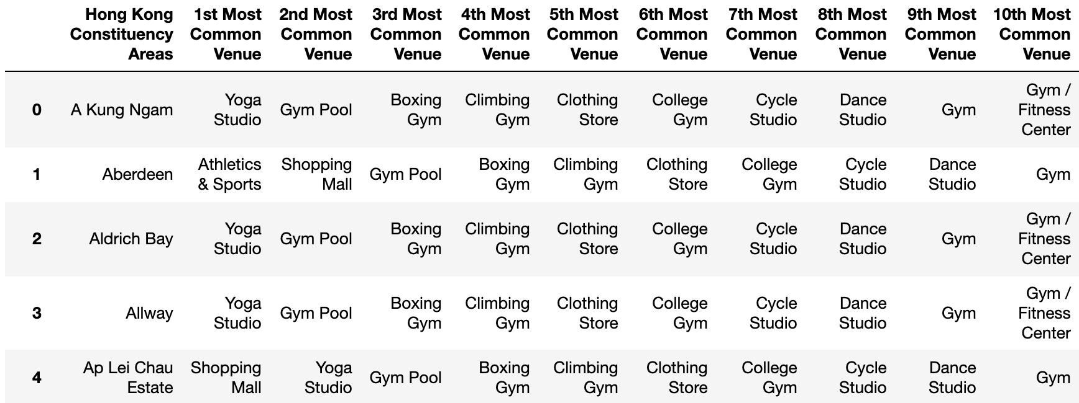
Data Analysis & Results
This project’s data analysis has 2 objectives:
Determining which areas in Hong Kong have greater numbers of fitness, clothing or shopping-related venues
Reflected by ‘Total’ venue numbers column
Understanding the areas’ venue-makeup (e.g. more gyms, clothing stores, or shopping malls)
K-means clustering to categorize the areas by their venue makeup, using top 10 most common venues

Slide 11
Data Analysis & Results: K-Means Clustering
We need to find an optimal number of clusters – the K-value
Method 1: Elbow Method
Run K-Means clustering for a range of K-values. For each K-value, we find the average of the squared distances for each point from the center of its selected cluster
We plot the K-values and distortion, choosing K-value after which the line appears more linear

Slide 12
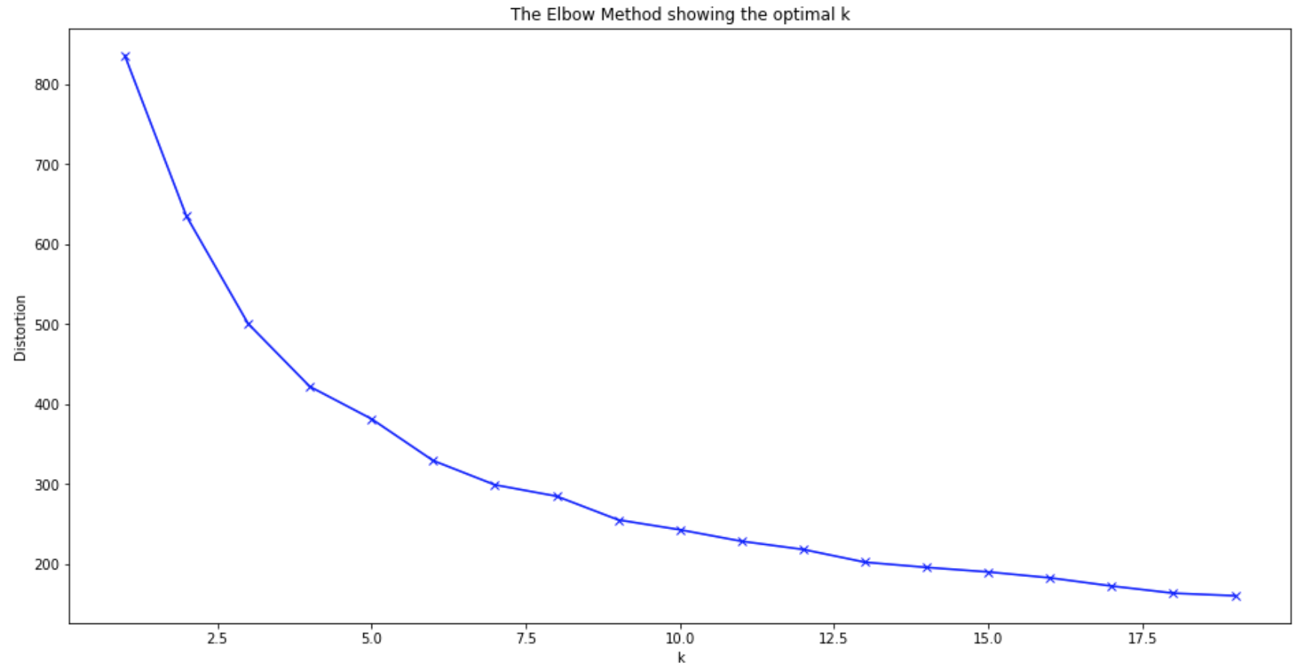
Data Analysis & Results: K-Means Clustering (cont’d)
Method 1: Elbow Method (cont’d)
The curve does not have an 'ideal’, sharp elbow to easily indicate a K-value. The line does begin resembling a straight line in the 10-15 range. We should use another method to improve our decision

Slide 13
Data Analysis & Results: K-Means Clustering (cont’d)
Method 2: Silhouette Analysis
Measures the degree of separation of the clusters from each other. We calculate a score for each sample point, reflecting its distance from other clusters.
The scoring range runs from -1 to +1
-1 implies that the sample point is much closer to another cluster and is therefore incorrectly assigned
0 implies that the sample point is right on the border between 2 clusters
+1 implies that the sample point is very close to its own assigned cluster.

Slide 14
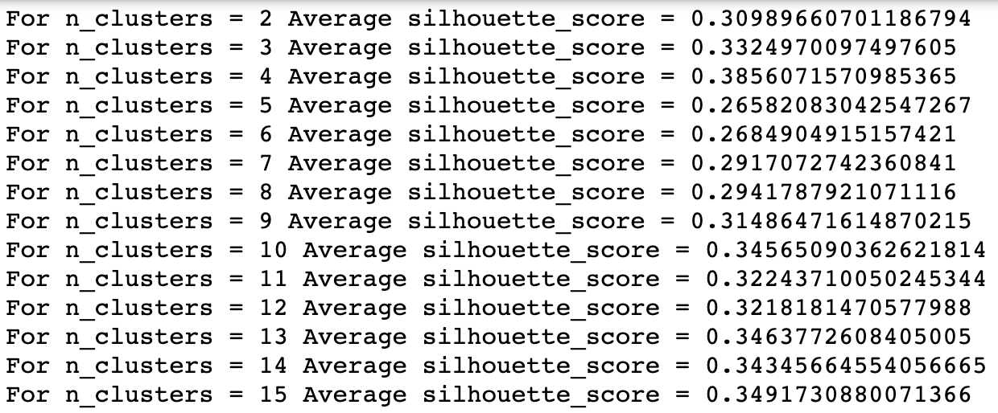
Data Analysis & Results: K-Means Clustering (cont’d)
Method 2: Silhouette Analysis (cont’d)
We will use a range of K-values from 2 to 15
Each cluster has its own silhouette coefficient, and an average silhouette score is calculated for a given K-value:

Slide 15
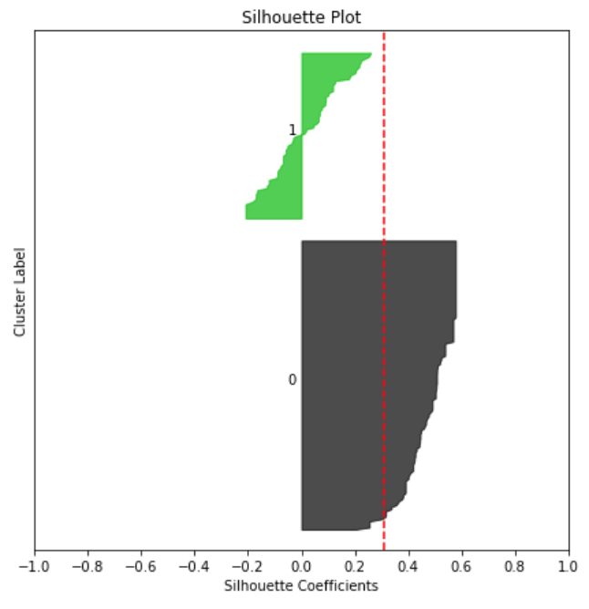
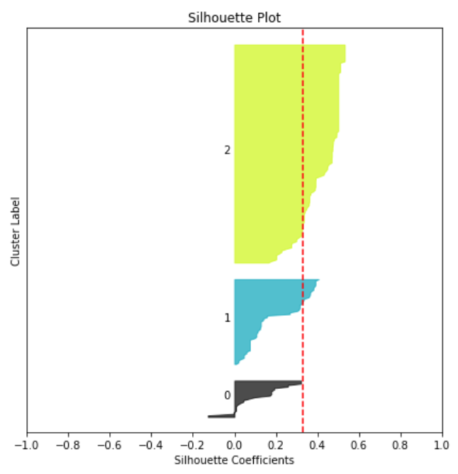
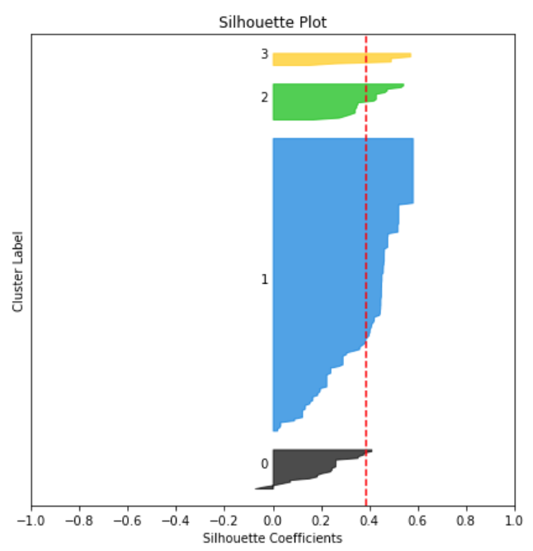
Data Analysis & Results: K-Means Clustering (cont’d)
Method 2: Silhouette Analysis (cont’d)
Producing silhouette plots for different K-values shows the silhouette coefficient, and the thickness of the plot reflects the size of the cluster size

Slide 16
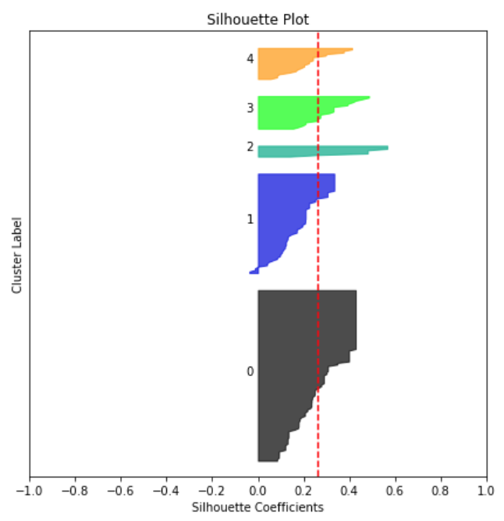
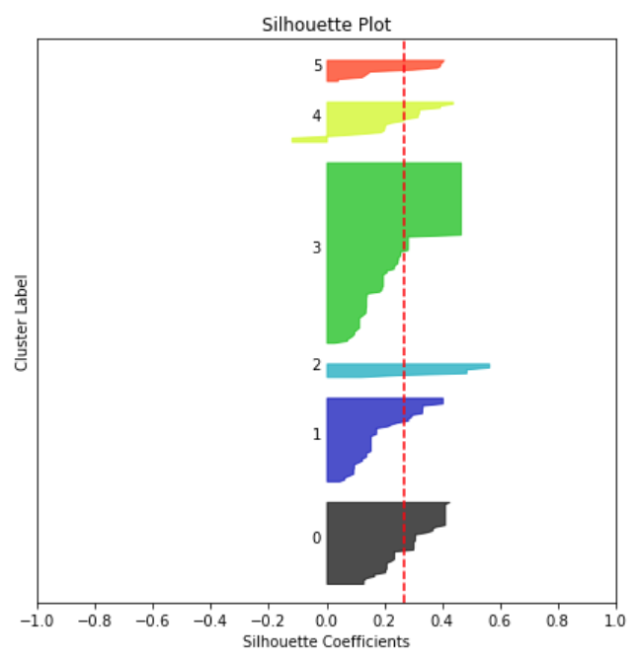
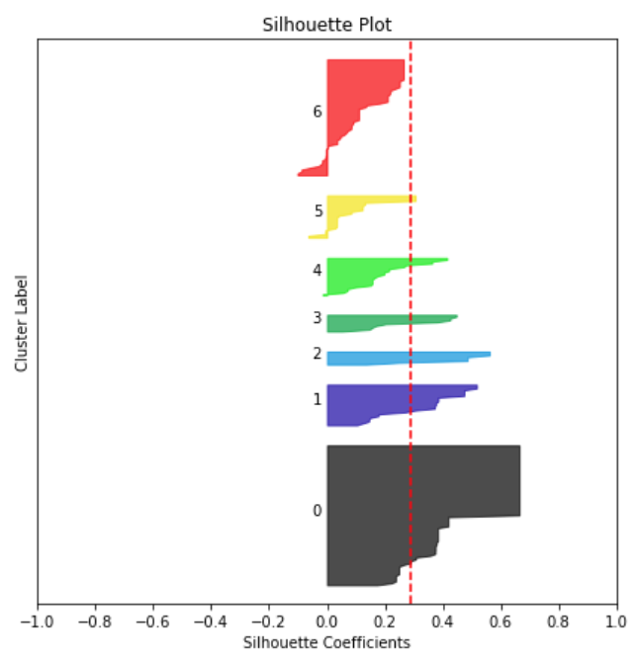
Data Analysis & Results: K-Means Clustering (cont’d)
Method 2: Silhouette Analysis (cont’d)
Producing silhouette plots for different K-values shows the silhouette coefficient, and the thickness of the plot reflects the size of the cluster size

Slide 17
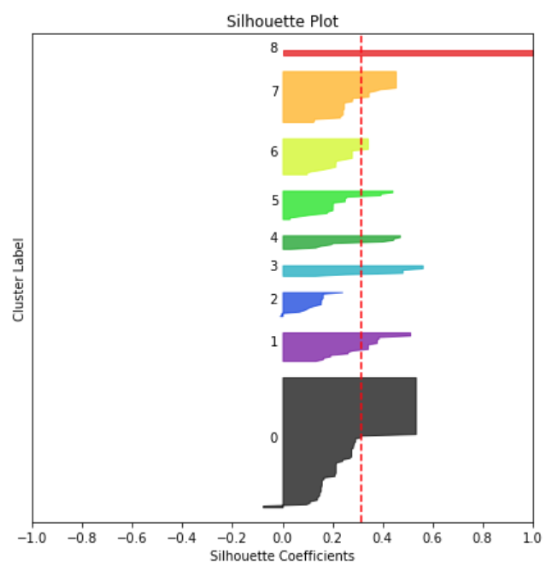
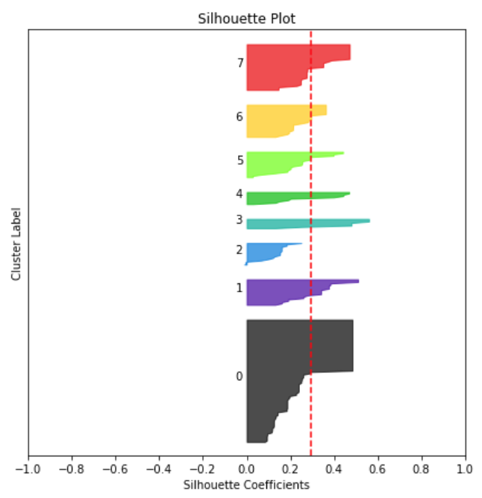
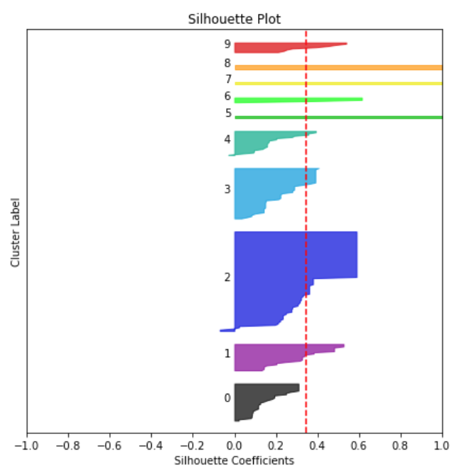
Data Analysis & Results: K-Means Clustering (cont’d)
Method 2: Silhouette Analysis (cont’d)
Producing silhouette plots for different K-values shows the silhouette coefficient, and the thickness of the plot reflects the size of the cluster size

Slide 18
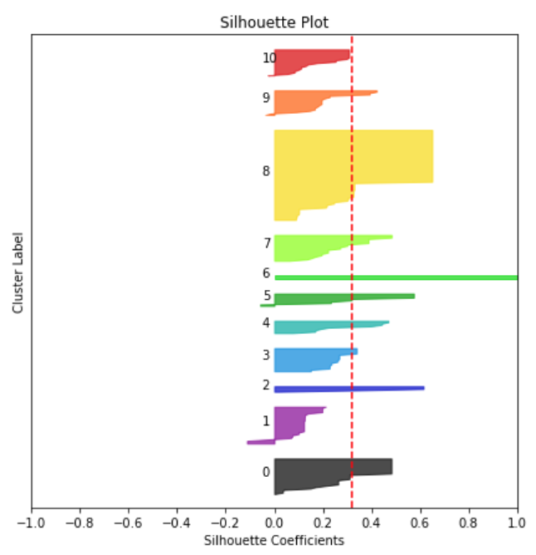
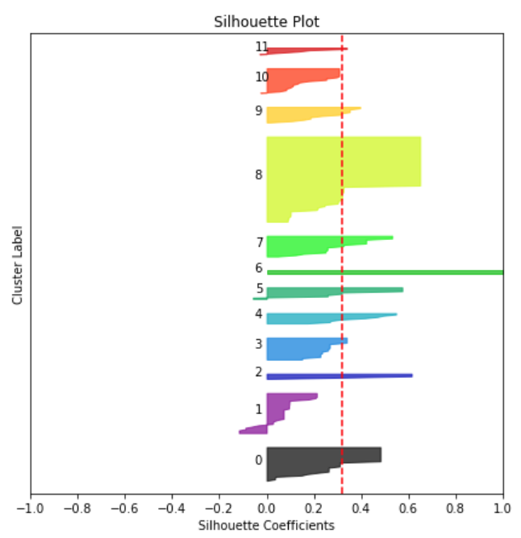
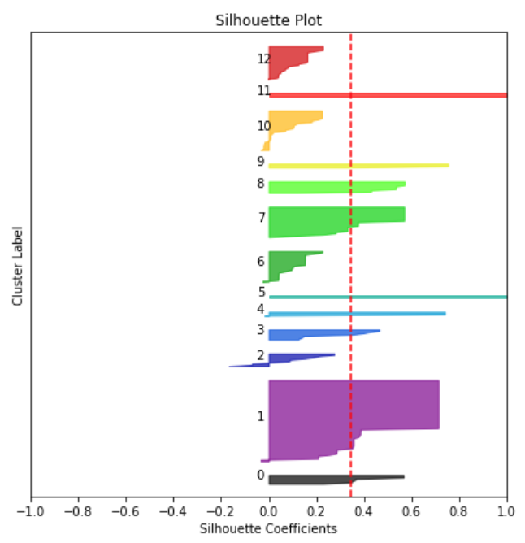
Data Analysis & Results: K-Means Clustering (cont’d)
Method 2: Silhouette Analysis (cont’d)
Producing silhouette plots for different K-values shows the silhouette coefficient, and the thickness of the plot reflects the size of the cluster size

Slide 19
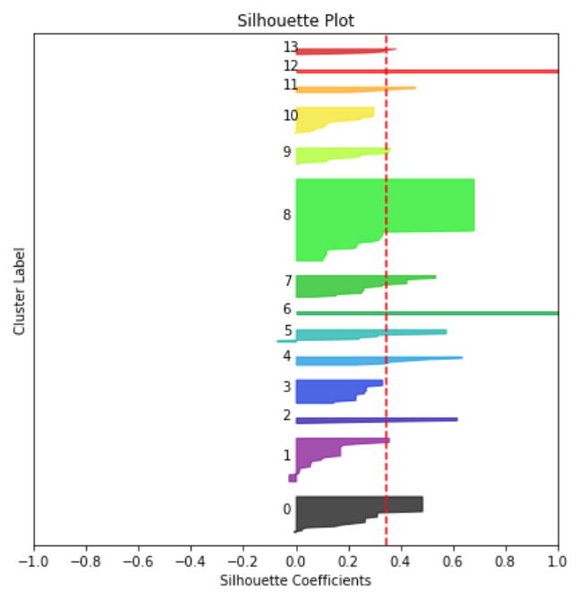
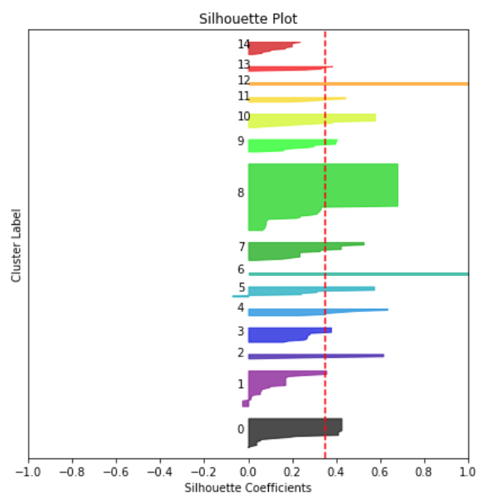
Data Analysis & Results: K-Means Clustering (cont’d)
Method 2: Silhouette Analysis (cont’d)
Producing silhouette plots for different K-values shows the silhouette coefficient, and the thickness of the plot reflects the size of the cluster size

Slide 20
Data Analysis & Results: K-Means Clustering (cont’d)
Method 2: Silhouette Analysis (cont’d)
A K-value of 15 offers a high silhouette score, but we are also concerned with the risk of overfitting
13 clusters seems to also yield a good silhouette score, so we will use K-Means Clustering to segment the areas into 13 different clusters

Slide 21
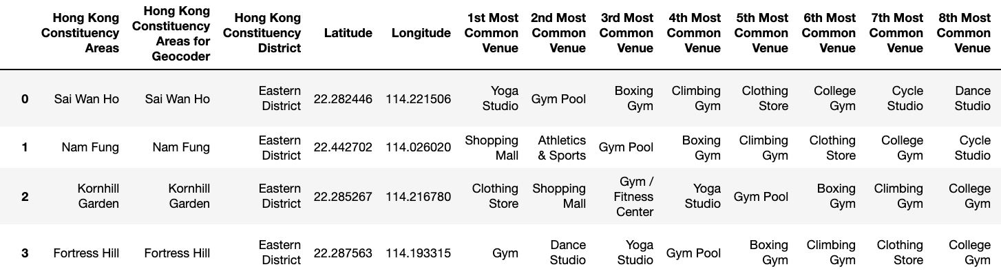
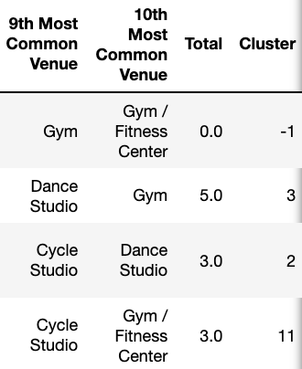
Data Analysis & Results: K-Means Clustering (cont’d)
Using the K-Means Clustering algorithm, we assign a cluster label (from 1-13) to each Constituency Area that has total venues greater than 0
For Constituency Areas with 0 relevant venues, we assign a cluster label of -1

Slide 22
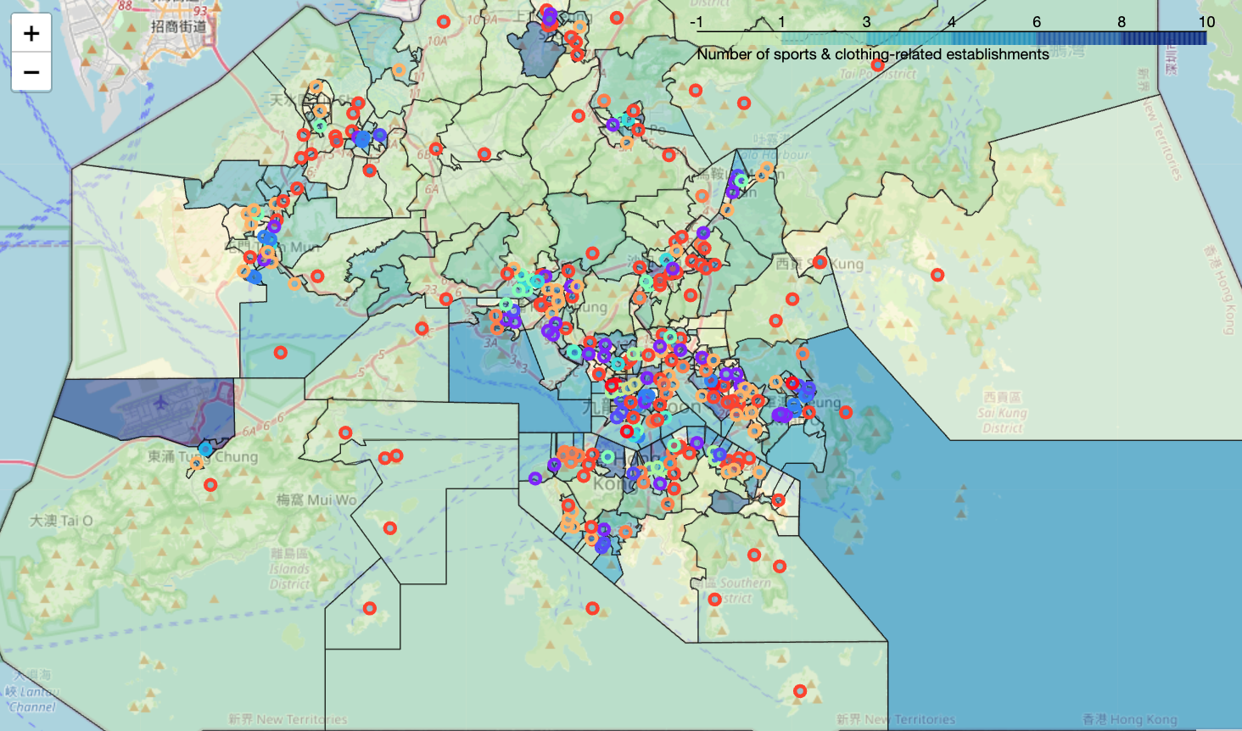
Data Analysis & Results: Geospatial Analysis
A map generated through Folium displays our results.
Using choropleth, shadings of blue indicate venue numbers for each area (darker = more numerous)
Circle markers show each area's name, district and cluster label; the color indicates the area’s cluster

Slide 23
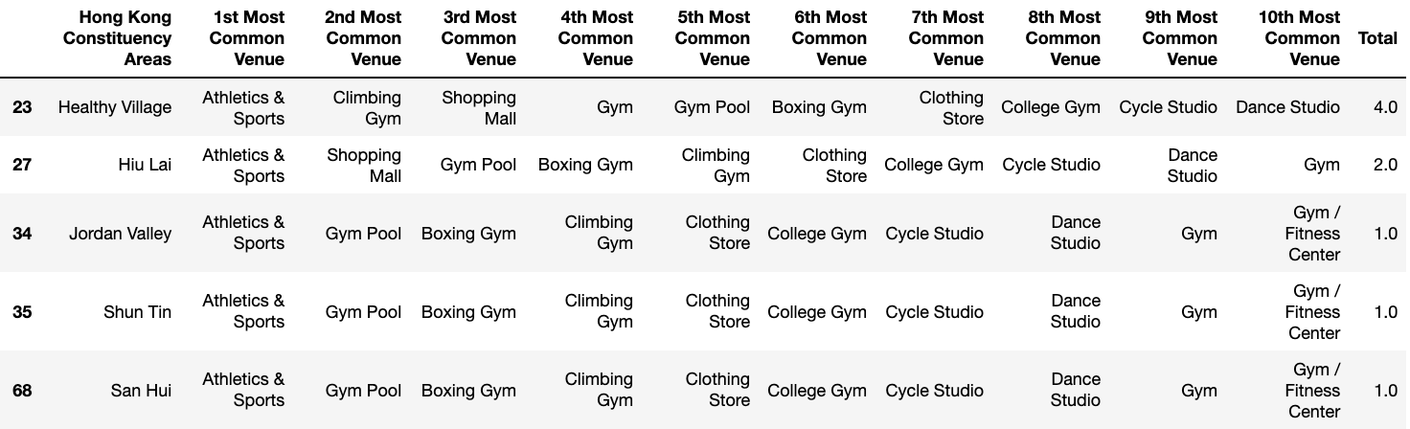
Data Analysis & Results: Cluster Observation
Filtering our dataframe, we can include only areas for each cluster
This way, we can observe the most important and discriminating features of each cluster
Cluster 1

Slide 24
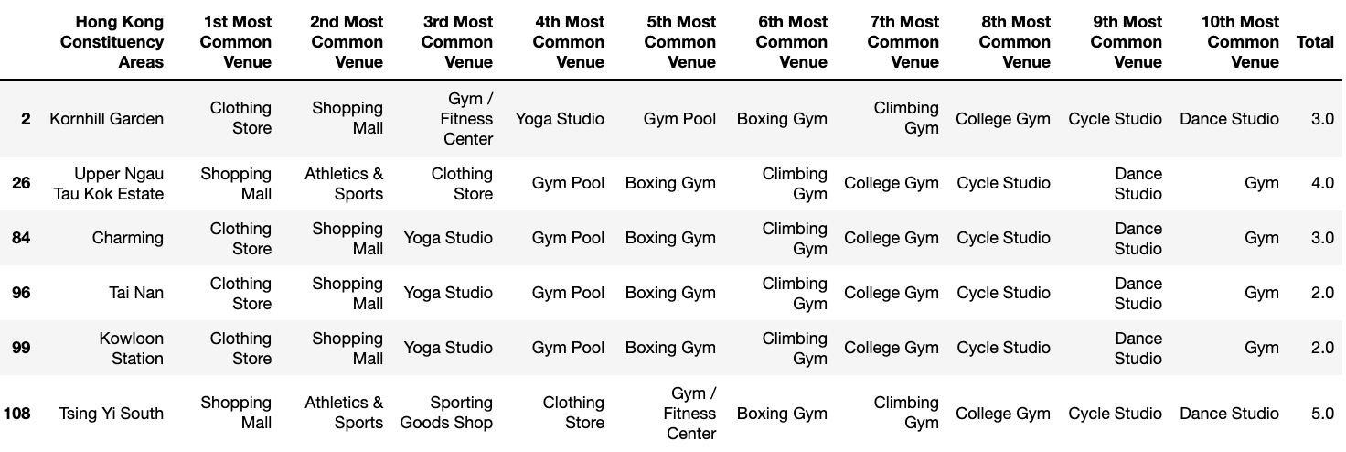
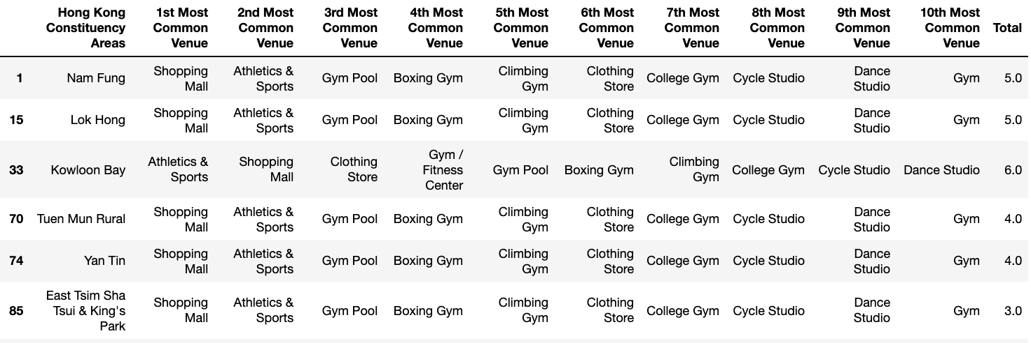
Data Analysis & Results: Cluster Observation (cont’d)
Cluster 2
Cluster 3

Slide 25
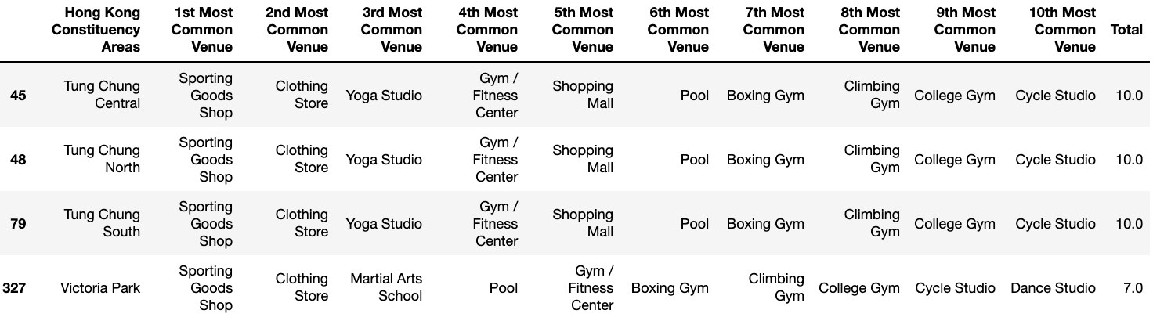
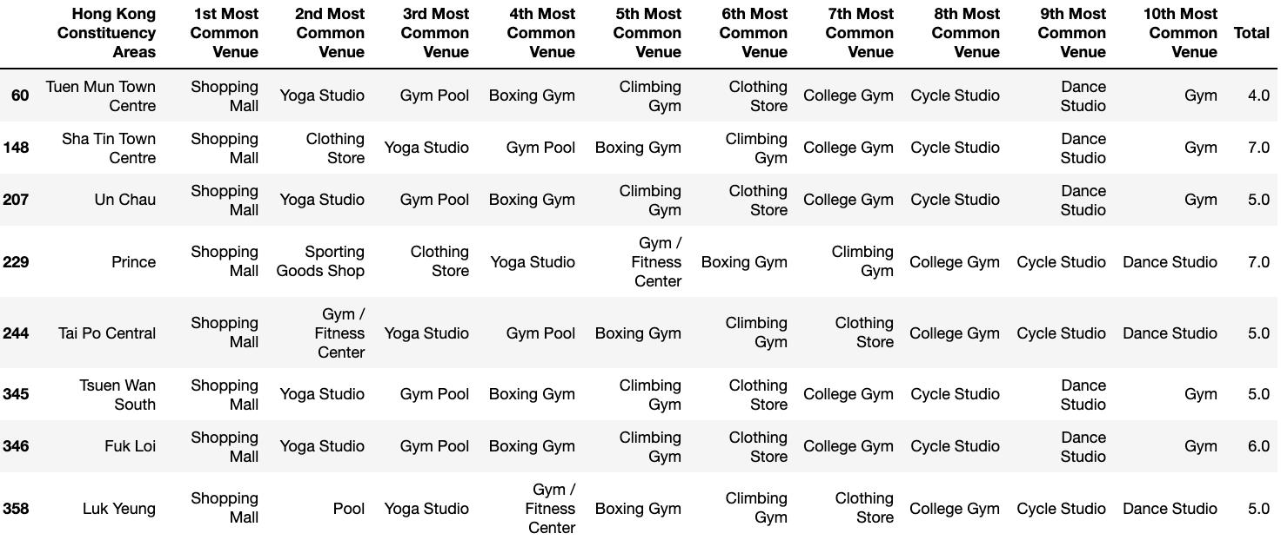
Data Analysis & Results: Cluster Observation (cont’d)
Cluster 4
Cluster 5

Slide 26
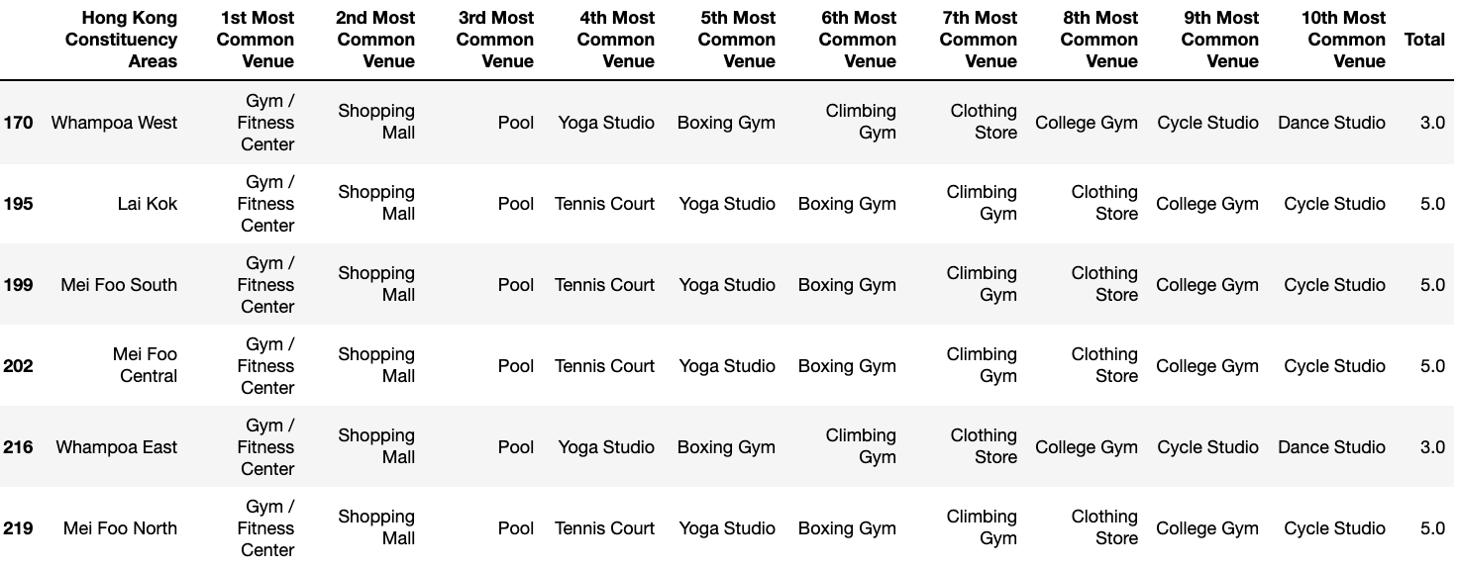
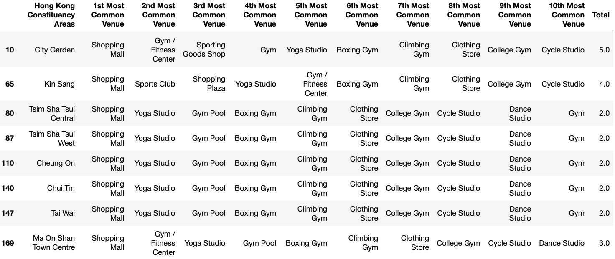
Data Analysis & Results: Cluster Observation (cont’d)
Cluster 6
Cluster 7

Slide 27
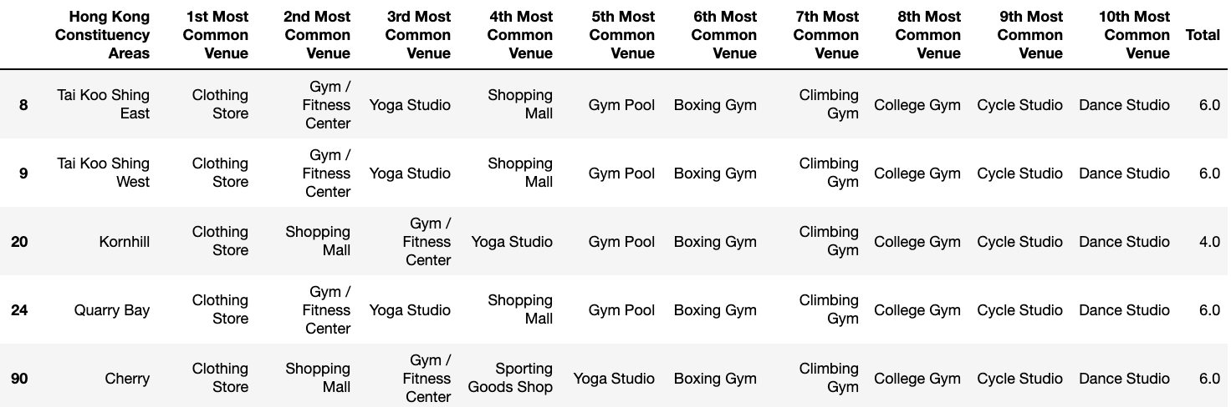
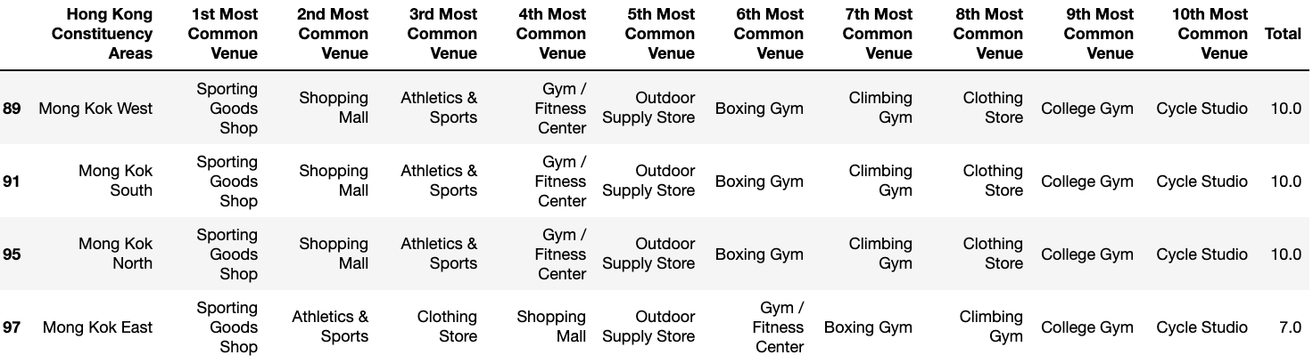
Data Analysis & Results: Cluster Observation (cont’d)
Cluster 8
Cluster 9

Slide 28
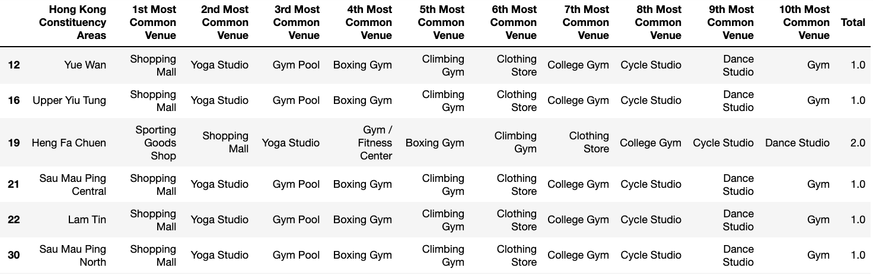
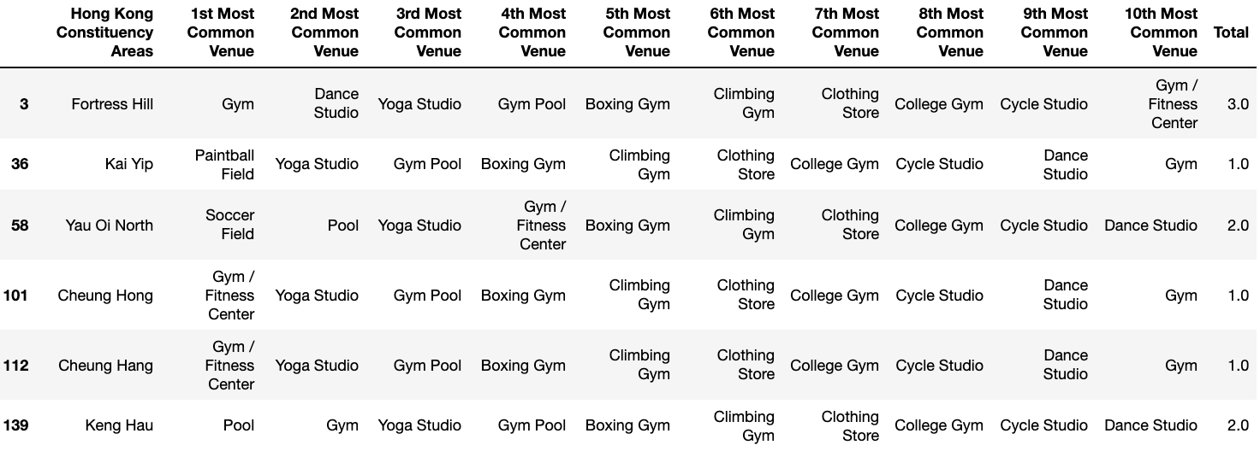
Data Analysis & Results: Cluster Observation (cont’d)
Cluster 10
Cluster 11

Slide 29
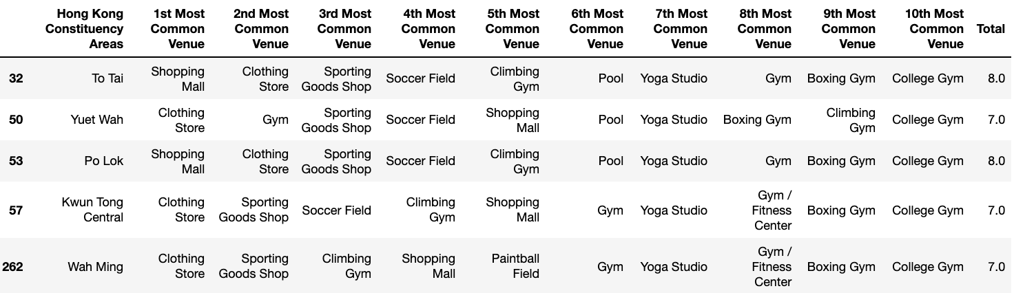
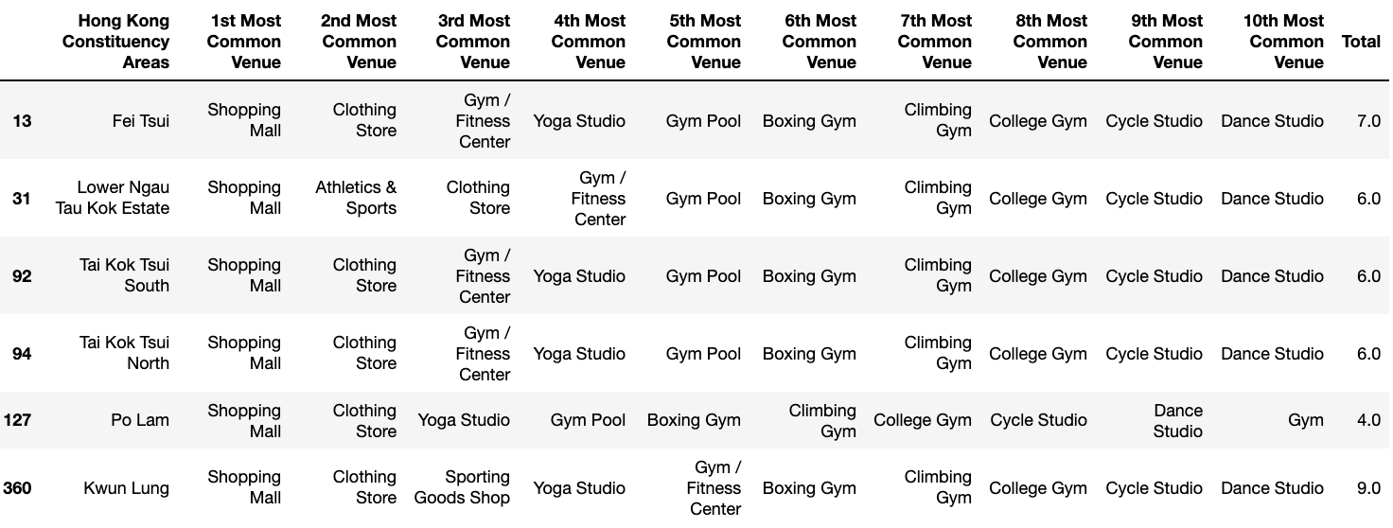
Data Analysis & Results: Cluster Observation (cont’d)
Cluster 12
Cluster 13

Slide 30
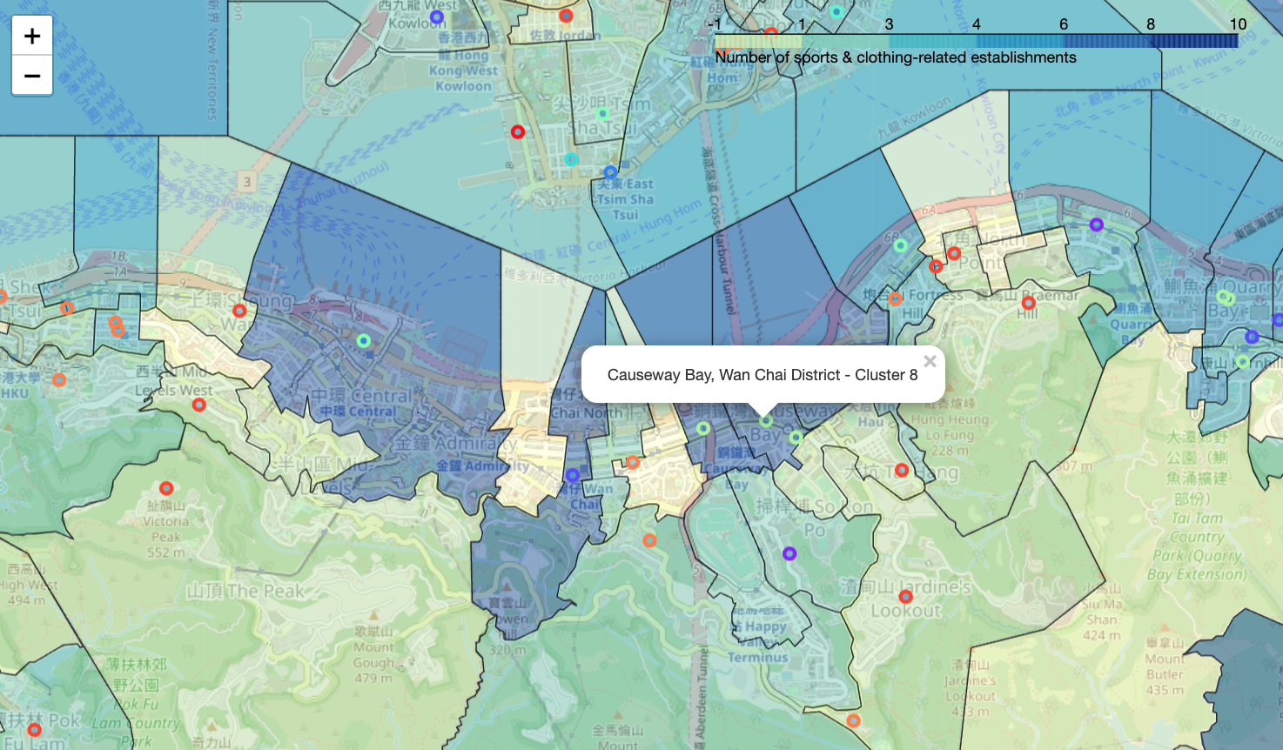
Discussion of Geospatial Analysis
Areas along the northern edge of Hong Kong island have darker shading, as the areas are widely known to be extremely urban, affluent, commercial and densely populated
The high occurrence of cluster 7 and 8 labels (in which shopping-related outlets are most common) shows high occurrence of shopping malls and gyms to meet the needs of higher-income, white-collar people
Sportswear stores in these areas can be smaller, higher-end, and focused on “athleisure” and general-purpose products. The high rent is an important consideration for a successful store location.

Slide 31
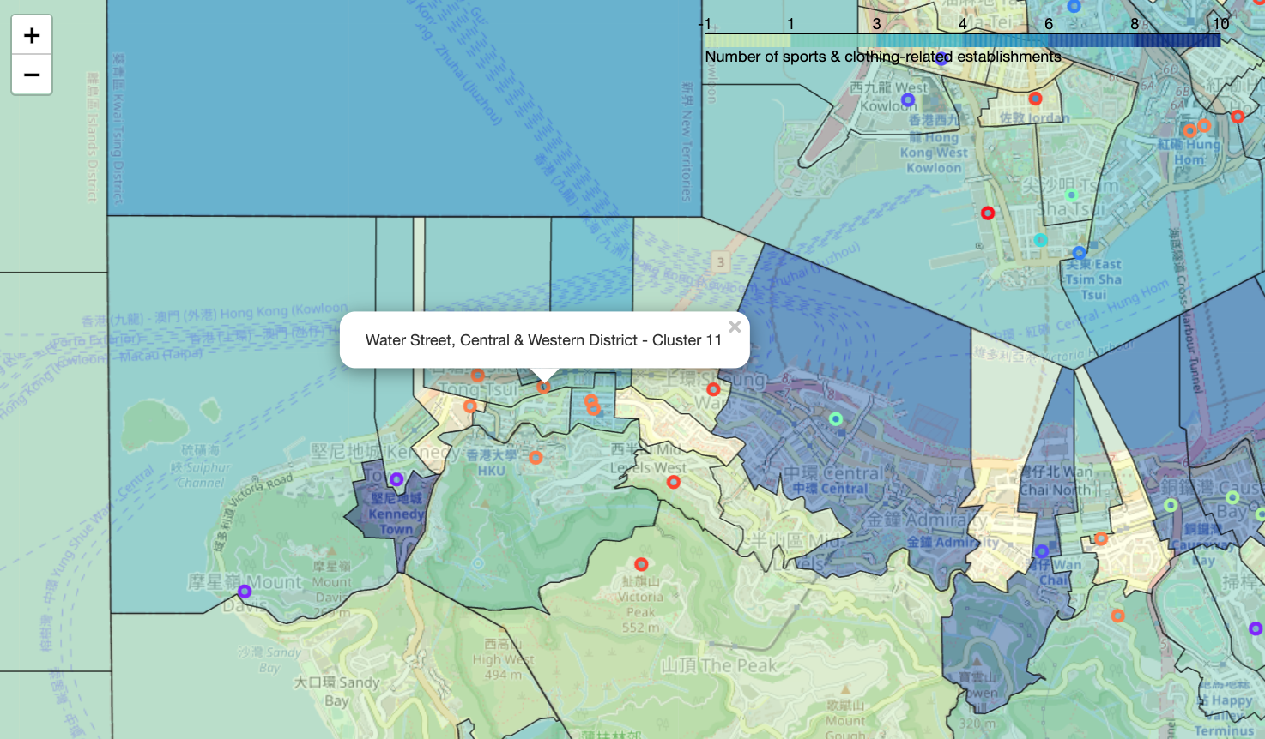
Discussion of Geospatial Analysis (cont’d)
Screen Shot 2021-02-27 at 10.50.34 AM
Cluster 11 labels on the western end of the northern edge (e.g. Sai Ying Pun, Hong Kong University, Kennedy Town) reflect a demand for fitness lifestyles amongst those who live in the more residential areas on Hong Kong island
Stores in these areas should still cater for the demands of consumers with more spending power, but their product offerings can be more fitness-focused compared to their downtown counterparts.

Slide 32
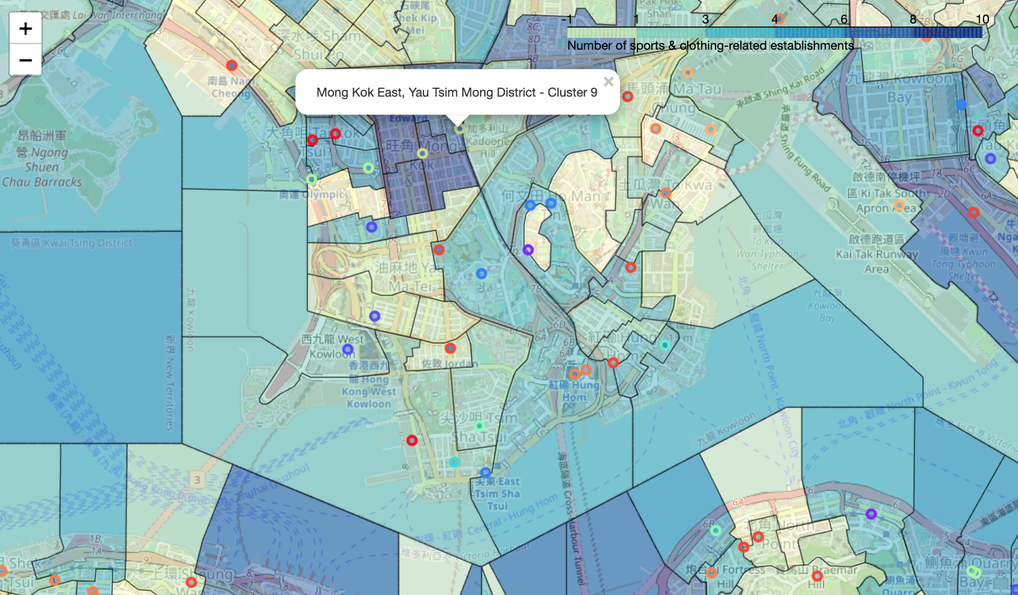
Discussion of Geospatial Analysis (cont’d)
Screen Shot 2021-02-27 at 10.50.34 AM
Some areas in Kowloon side have darker shading as they are densely populated and popular amongst younger crowds (residents and consumers alike)
Cluster 2 and 9 labels imply that younger demographics have demand for fashion and sports clothing outlets. By extension, we can hypothesize that areas with younger audiences (often due to lower rent and vibrant "hip" environments) are promising sportswear store locations
Stores in these locations should reflect local tastes, such as by being more trendy, affordable and fitness-focused.

Slide 33
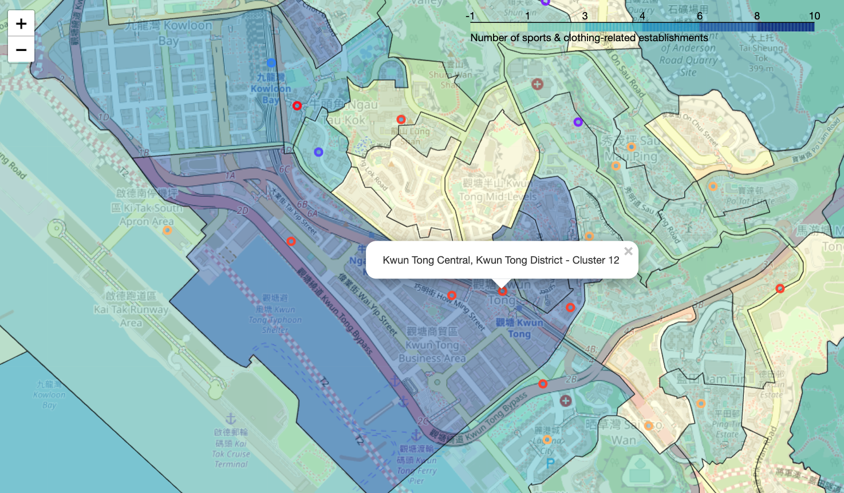
Discussion of Geospatial Analysis (cont’d)
Screen Shot 2021-02-27 at 10.50.34 AM
Kwun Tong also has darker shading - cluster 12 labels indicating shopping centers and clothing stores
This may be attributed to its dense and residential population
The relatively affordable property prices make Kwun Tong a less expensive store location, but the lower average income of its residents will reduce their purchasing power
A unique characteristic of cluster 12 areas is the higher number of soccer fields
We may consider offering more soccer-related sportswear products to cater to local demands.

Slide 34
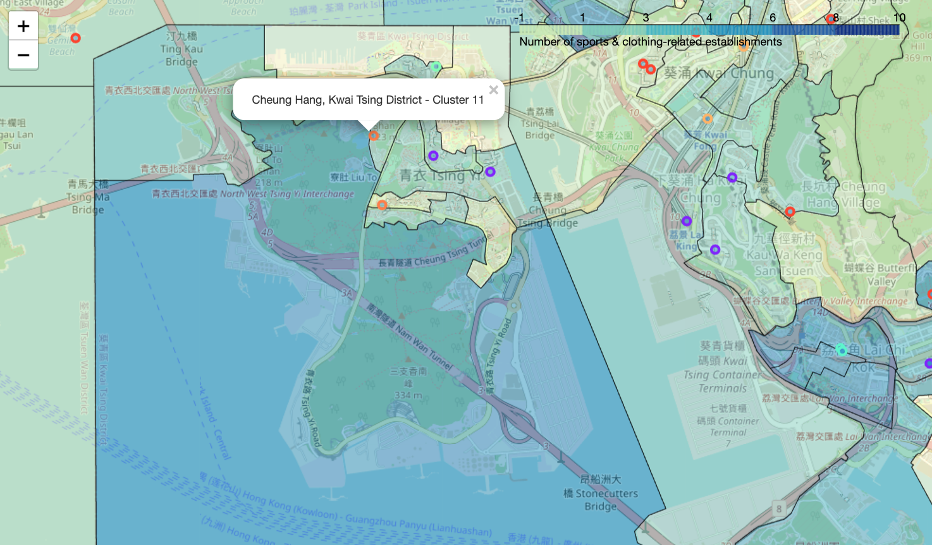
Discussion of Geospatial Analysis (cont’d)
Screen Shot 2021-02-27 at 10.50.34 AM
In Tsing Yi, cluster 1 and 11 labels reveal a high number of fitness-related venues (e.g. Pools, Boxing Gyms, Fitness Centers, Climbing Gyms)
This is likely attributed to Tsing Yi’s more spacious and residential environment
Stores in this area can be larger, fitness-focused and family-oriented. Partnerships with local fitness-outlets can also be promising.

Slide 35
Conclusion
We now have a granular understanding of which areas have fitness and fashion-ecosystems
Areas with more venues imply greater interest in fitness and fashion, as well as more economic potential
We understand the specific types of venues in each area. Some areas emphasize on fashion and shopping, others on sports and fitness
All these insights are useful for a successful sportswear store expansion strategy
For further analysis we can continue exploring other important factors:
Population density
Average income for residents
Foot traffic
Economic trends
More granular features of the venues (e.g. high or low-end, specific sports)

